Slide 1
Office 365 development

Slide 2
Deep dive into the Office 365 Video API
</>

Slide 3
Developer vision

Slide 4
Agenda
Introducing Video Portal
Using the Office 365 Video API

Slide 5
1
Introducing Video Portal

Slide 6
Gartner “projects that, by 2016, large companies will stream more than 16 hours of video per worker, per month.”
SOURCE: Gartner Magic Quadrant for Enterprise Video Content Management, Whit Andrews, September 2013

Slide 7

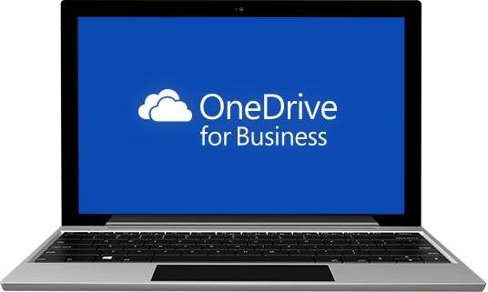
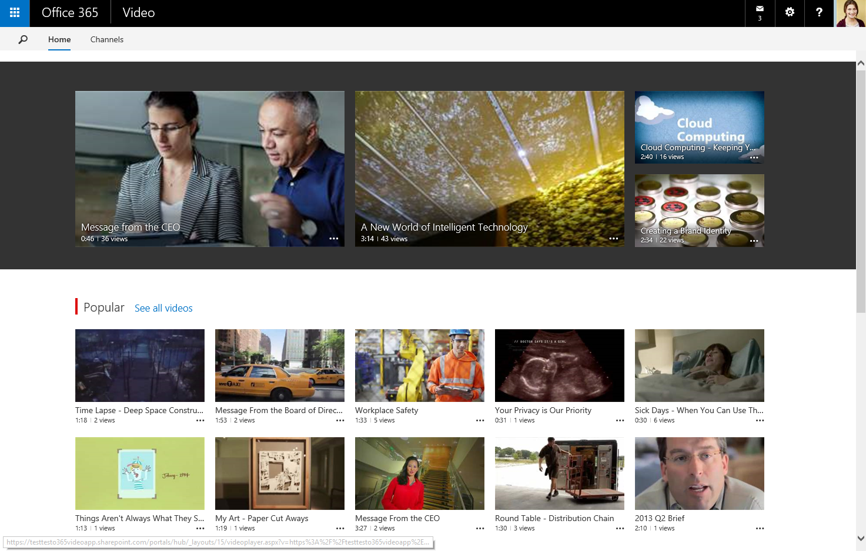
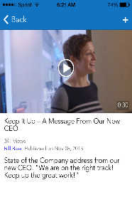
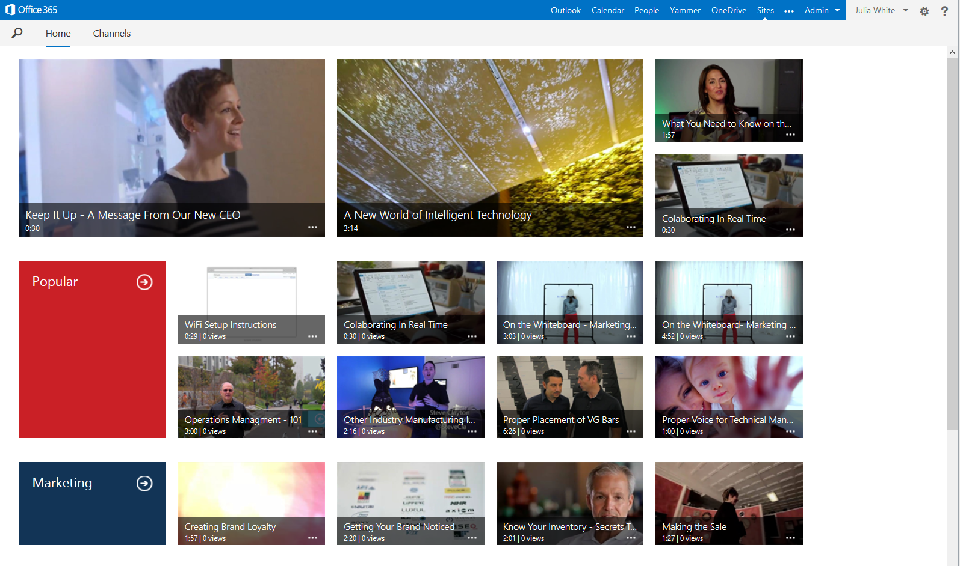
Office 365 Video Portal
SIMPLE | FAST | MOBILE | SECURE
Easily consume video
Modern, mobile, “everything in one place” video destination
Share ideas broadly
Rich, discoverable, social video across devices
Secure and easy to manage
Scalable, encrypted, cross-geo video streaming service

Slide 8
Key uses
Training
Corporate messages
Community
Help and how to

Slide 9
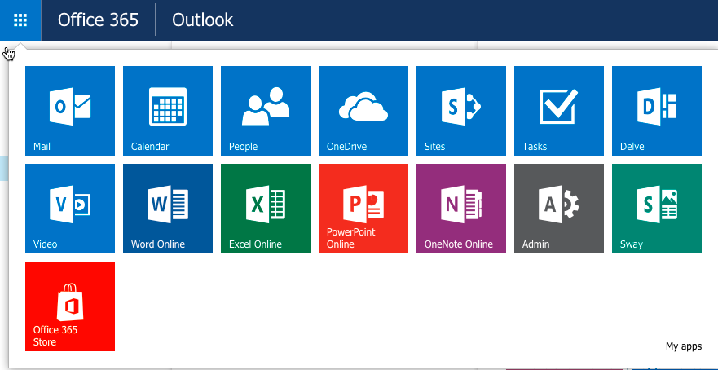

Slide 10
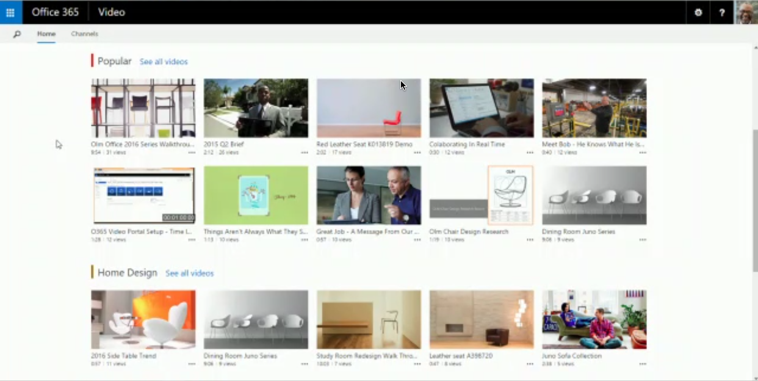

Slide 11
Powered by SharePoint Online and Azure Media Services
SharePoint Online
Content storage
Metadata
Security and compliance
Search
Azure Media Services
Transcoding
Adaptive streaming
Secure delivery
Thumbnails

Slide 12
HTML5 mobile playback in browser—Windows, Android, and iOS
Responsive player playback page
Office 365 for iPhone app
Built-in CDN—better playback performance across geographic locations
More granular permissions per channel—owners/editors/viewers
Related videos powered by the Office Graph
REST APIs for Office 365 Video (in preview)
Current Video Portal capabilities

Slide 13
Embed into other Office 365 locations outside of the Video Portal
Responsive design for all Video Portal pages
More personalized Home Page powered by the Office Graph
Hybrid link to Office 365 Video from SharePoint Server 2016
“Publish to” from Skype for Business into an Office 365 Video channel
Future Video Portal capabilities

Slide 14
Exploring the Office 365 Video Portal
demo

Slide 15
2
Using the Office 365 Video API

Slide 16
Office 365 Video API

Slide 17
Introducing the Video API
Discover and interact with videos in the Office 365 Video Portal
Provides access to…
Video Portal
Channels
Videos
Video REST API currently in preview
Some things may be changed, added, and removed

Slide 18
Video Portal operations
// get the Video Portal API endpoint
// requires HTTP Authorization header
// for authentication
HTTP GET
https://<tenant>.sharepoint.com/
_api/VideoService.Discover

Slide 19
Channel operations
List all channels user can view and edit
HTTP GET: [..]/_api/VideoService/Channels
HTTP GET: [..]/_api/VideoService/CanEditChannels
Details on a specific channel
HTTP GET: [..]/_api/VideoService/Channels('<guid>')
All videos in a channel
HTTP GET: [..]/_api/VideoService/Channels('<guid>')/Videos

Slide 20
Video API: Working with channels
demo

Slide 21
Video operations
Details on a video
HTTP GET: [..]/_api/VideoService/Channels('<guid>')/Videos('<guid>')
Details on playing a video
HTTP GET: [..]/_api/VideoService/Channels('<guid>')/Videos('<guid>')/ GetPlaybackUrl('<playbacktype>')
// Playback type 0 = smooth streaming / MPEG-DASH
// Playback type 1 = HLS streaming

Slide 22
Video API: Working with videos
demo

Slide 23
Managing videos
Creating videos
First create placeholder—does not include the file
Then upload the file
Upload in a single upload (ideal for small videos)
Upload in chunks to avoid timeouts (suited for large videos)
Update video metadata
Delete videos

Slide 24
Video API: Managing videos
demo

Slide 25
Summary
Introducing Video Portal
Video API

Slide 26
Developer Program launch
1 YEAR FREE
Email Newsletters
Free Developer Subscription
Free Training
Free Tools
Webinars
http://dev.office.com/devprogram

Slide 27
Engage

